Slide 1
ALBANY ASSOCIATES
Using communications to solve complex problems in challenging environments

Slide 2

ALBANY ASSOCIATES
Covering PVE topics through media in different contexts – an Albany Associates perspective
Notes:
My name is Valeriya Lindholt, and I am an account manager at Albany Associates.
Today, speaking about:
What we have found to be the best international standards for working with media stakeholders when it comes to PVE
I wish to share some insights from our ongoing work, and lessons learnt that inform this work, during this talk.

Slide 3
Working across
the world
Notes:
While our work is global, the challenges are local.
We work in East Africa, in the Middle East, in the Western Balkans, in Eastern Europe and here in Central Asia. We have presence across four continents where, amongst other topics, we work on the global and local threat posed by violent extremism.
This has included:
Alternative narrative work with the Information Support Team in Somalia.
Projects aimed at enhancing, enabling and getting local voices in Europe and across the world to speak up about VE issues.
Work with journalists on capacity building for PVE coverage in Eastern Europe and here in Central Asia with Internews.
Throughout our work, we have found that what is truly impactful is when you take global learning and bring it to a local level.

Slide 4
It is local
Notes:
All politics is local, and all grievances are rooted in the individual’s experience.
We are guided by the belief that what works in Belgrade will not work in Bishkek.
But we also know, that there are useful cross-overs between what has been done in Somalia and what could be done in Sudan. What we have done in Darfur and what we can do in Dushanbe.
Partners and trusted networks are key in the way we work and encourage other organizations to work.

Slide 5
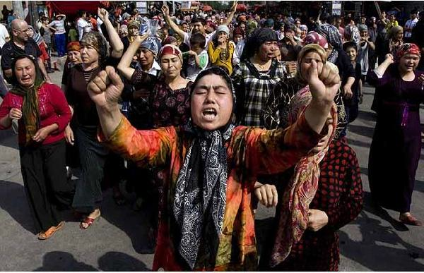
It’s not initially about religion or radical ideology but local conditions and circumstances.
Terrorists, extremists and insurgents exploit local conditions and grievances.
Their ideology provides an alternative to local administration, community or state failure.
Ideology or
grievance?
Notes:
Knowing this, we emphasize the importance of understanding.
VE is about grievances. It’s not initially about religion or radical ideology but local conditions and circumstances. Terrorists, extremists and insurgents exploit local conditions and grievances. Their ideology provides an alternative to local administration, community or state failure.
To understand, we therefore apply robus research – combined with wat we have learnt from doing similar work in other places. In short - robust research and expertise is need, in order to gain a thorough understanding of VE issues where we work. Here in Central Asia, this has led us to work closely with Internews and partners in designing and shaping research on PVE topics.
Image source: Wall Street Journal

Slide 6
Narratives and counter-narratives
Capacity building for media - PVE training
Notes:
So what are some of the ways in which you can engage with the media on PVE issues?
Two schools of though:
narratives and counter-narratives vs
capacity building and trusting that open dialogue and understanding is the better approach
Narratives and counter-narratives are things we can do as practitioners in the PVE space. We have had success with them in the past.
But it may not always be the place for journalists and the media. Pushing messages can come at odds with independent media.
And while the responsibility is not on the media, there is a degree of understanding required in a media community in order to cover VE issues. Just like you would expect training on data journalism, economic understanding and health science, we believe in capacity building for media to cover PVE content.

Slide 7
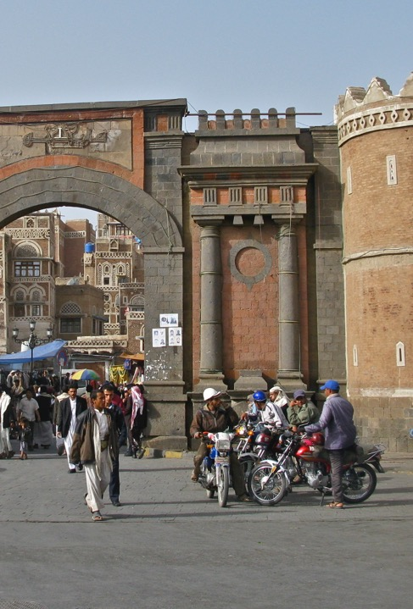
Building capacity of media actors to engage with P/CVE topics. Going beyond the surface. Sensitivity and understanding of the issues.
Two way communication.
Local voices. Audience needs to find them credible.
Notes:
We know this to be true across the many regions where we work. There is a very important difference between glorifying and informing on VE. Terrorists thrive off the attention and terror created by their actions and ideas. Doing the deed of terrorists and extremists for them. PVE training for media community members as a solution.
This building capacity of media actors to engage with P/CVE topics is about going beyond the surface. We are doing it with journalists in eastern Europe and Central Asia. Sensitivity and understanding of the issues. – journalist training.
Additionally – creating the conditions for two way communication. – it is at the core of everything we do, and what we have found to be effective when working on PVE issues. This is about working with the media community and authorities to get better at dialogue.
Seeking out local voices. Audience needs to find them credible. – South East Asia with Hedayah. South Sudan.
Could change pictures to some training photos.

Slide 8
It has to be local
Notes:
As such, to work on PVE topics through the media in different contexts, one needs to look at it as a local matter. It has to be local and suited to the context – but a good degree of lessons learnt and expertise from working in other similar contexts aids effectiveness.

Slide 9
www.albanyassociates.com
valeriyalindholt@albanyassociates.com

