Slide 1
Not without risks: Working with the media and counter-messaging for PVE
Kloé Tricot O’Farrell, Conflict & Security Adviser, Central Asia
7 December 2018
Notes:
Title page
This is an example of PowerPoint’s notes feature in action.
Additional notes can be added to slides by typing in the notes pane in the normal view, these can then be printed out as notes pages which feature a picture of the slide.
This feature is useful for giving background information to your audience before or after your presentation.

Slide 2
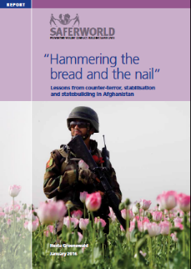
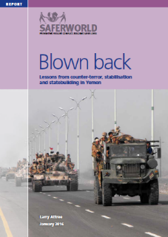
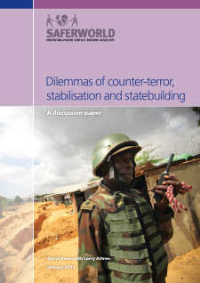
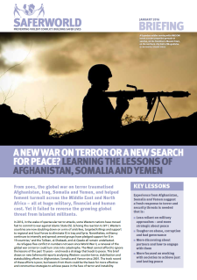
Evidence, analysis & dialogue

Slide 3
A. The risks posed by C/PVE
It ignores the problematic agendas and behaviours of certain actors;
It focusses on certain issues;
It seeks to establish simplistic causal links to achieve a narrow objective;
In spite of the name, it is more about reaction than prevention…

Slide 4
B. The problems with counter-messaging
It is difficult to develop messages and narratives which resonate and reach target audiences;
It can reinforce people’s beliefs and create anger;
It can stigmatise, foment division and cement repression;
It tends to close and control the debate;
It puts local partners in a difficult position;
It distracts from what is really needed: improving people’s lives.

Slide 5
C. What can be done?
Shift from top down messaging to promoting dialogue and listening to concerns;
Ensure people can trust your communications:
Information should be objective and grounded in evidence;
Information should be shared to benefit the people receiving it, not to better control them;
Don’t make promises you can’t keep;
Peace education is important, seeing it work in practice even more so
Actions speak louder than words: focus on improving people’s lives

Slide 6
Спасибо!
www.Saferworld.org.uk
ktricotofarrell@saferworld.org.uk

