Slide 1
ALBANY ASSOCIATES
Using communications to solve complex problems in challenging environments
Notes:
My name is Fatma Ahmed and I am currently the Africa Director of Albany Associates, an international company which uses communication to solve complex problems in challenging environments.

Slide 2

ALBANY ASSOCIATES
Tackling Violent Extremism using Technology, Innovation and Communication
Notes:
My presentation is focused on drawing on Albany’s experience in tackling violent extremism using technology, innovation and communication. For the next 10 minutes I will focus on concrete examples and projects that I have designed and implemented in Africa using Communication, Innovation and Technology to Prevent Violent Extremism and build resilience from the grassroot level.

Slide 3

Violent Extremism
Violent Extremism in Africa:
al Shabaab
Boko Haram
al Qaida
ISIS
All these groups use media as part of their tools used to recruit
Notes:
Violent extremism

Slide 4
A Comprehensive Approach
Our approach to communicating prevention on violent extremism:
Assess – local trigger, driver and issue analysis
Develop – local capabilities and alternative narratives
Deliver - local actionable and realistic outcomes and outputs
Innovate – inclusion of creative and tech actors
Sustain – mentoring and coaching
Evaluate – iterative feedback loops matched to milestones
ASSESS
DEVELOP
DELIVER
INNOVATE
SUSTAIN
EVALUATE
Notes:
Our approach to supporting Prevention of Violent Extremism is through a comprehensive approach to promote local resilience. Our six step approach focuses on:
Assess - Develop - Deliver - Innovate - Sustain - Evaluate
At the heart of this approach is communication as we understand the crucial role it plays to the recruitment and radicalisation of vulnerable communities and youth at the grassroot level.
This approach allows us to equip, empower and encourage content and narratives which challenge violent extremism.

Slide 5
COMMUNICATION
Notes:
The role of communication in PVE.

Slide 6
Narratives
Extremist
Political and Military Narratives
Social and Personal Narrative
Ethnic and Clan Based Narratives
Religious and Ideological Narratives
Economic Narratives
Group Integrity Narrative
Narratives
Notes:
We start by first trying to understand the narrative of the extremist are deploying and their tactic. Using Somalia as an example, one of our projects classified six predominate narrative categories used for recruitment.

Slide 7
Understand their medium
We then analyse and understand the medium used to spread the extremists narrative and propaganda.
In the case of Africa radio is the most popular medium used.

Slide 8
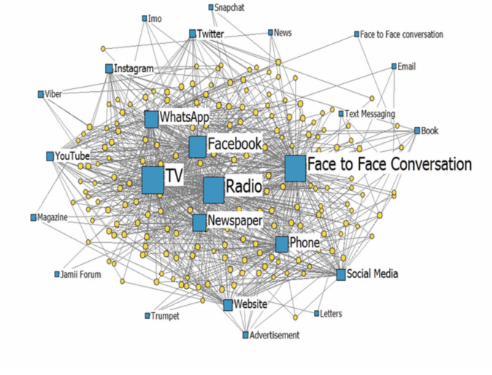
Information Ecology
Our preventative communication efforts focus on better understanding the information ecology.
Localised social network and stakeholder analysis
Understanding the most influential channels and devices used
Appealing content types and format
Popular media and mediums
Influential messengers
Graph from SFCG report “Meet Me At the Muskani” (2017)

Slide 9
INNOVATION
Notes:
The role of innovation in PVE

Slide 10
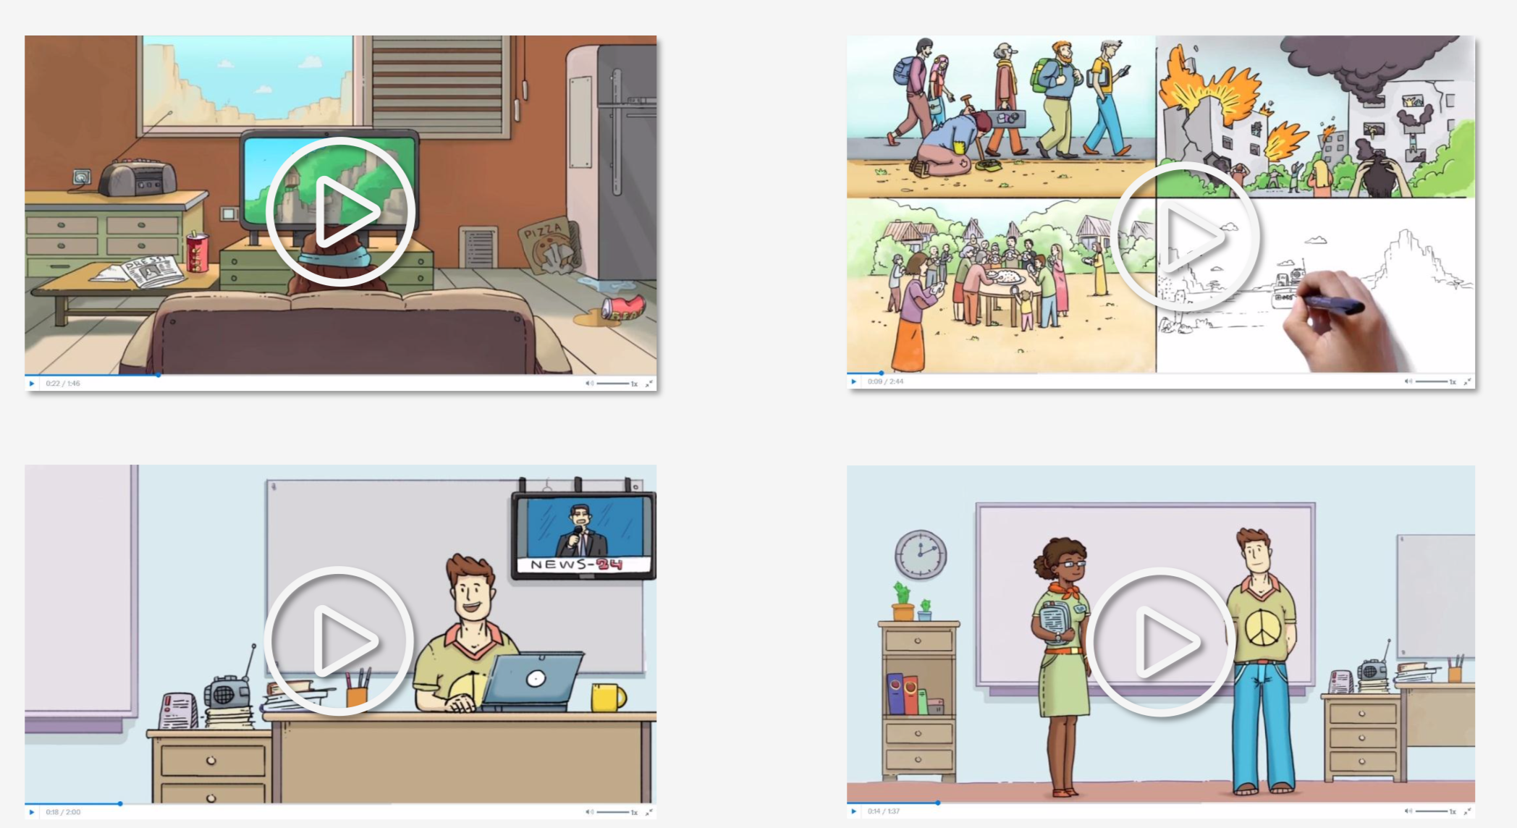
Notes:
Innovation lab

Slide 11
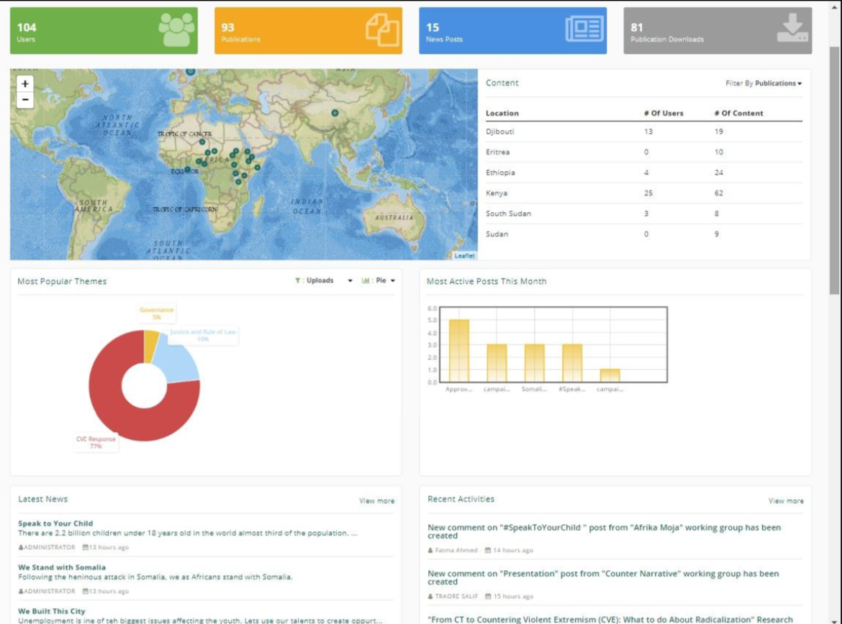
Notes:
Promote networking and shared knowledge

Slide 12

Notes:
Integrate feedback and evaluation

Slide 13
TECHNOLOGY
Notes:
The role of Technology in PVE

Slide 14

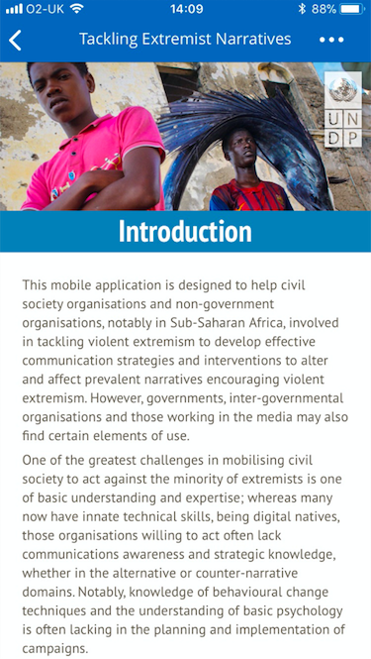
Tackling Extremist Narratives
A mobile resource in the palm of the hand, anywhere, anytime

Slide 15
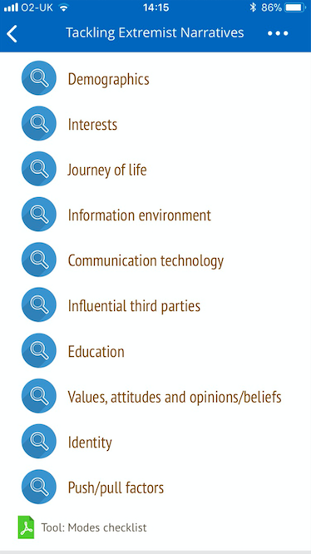
Tackling Extremist Narratives
Digging deep into audience analysis

Slide 16
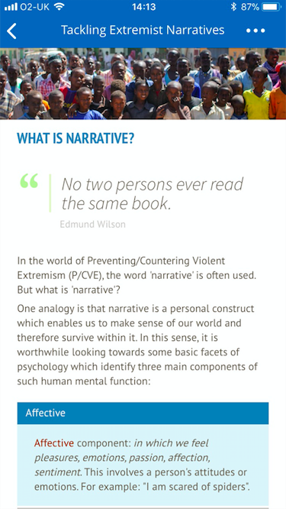
Tackling Extremist Narratives
Examining narratives and psychology

Slide 17
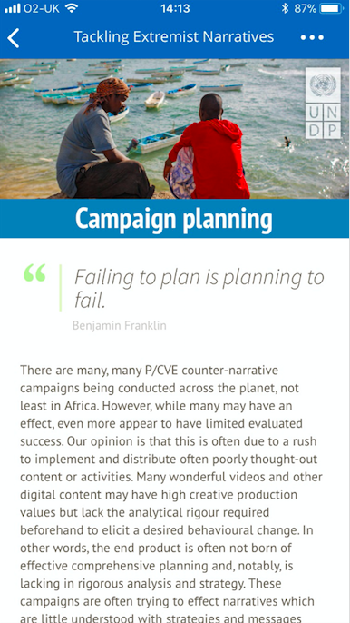
Tackling Extremist Narratives
Employing comprehensive campaign planning

Slide 18
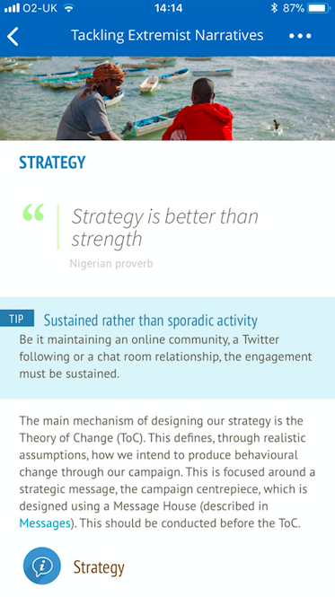
Tackling Extremist Narratives
Promoting the development of strategy

Slide 19
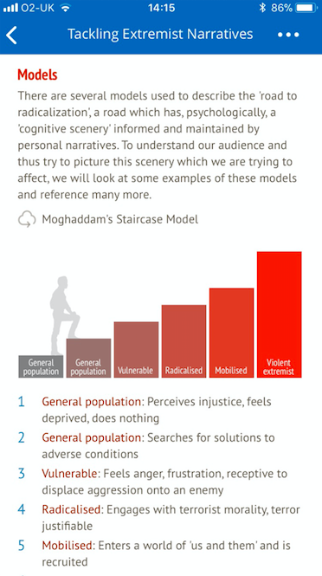
Tackling Extremist Narratives
Examining various models

Slide 20
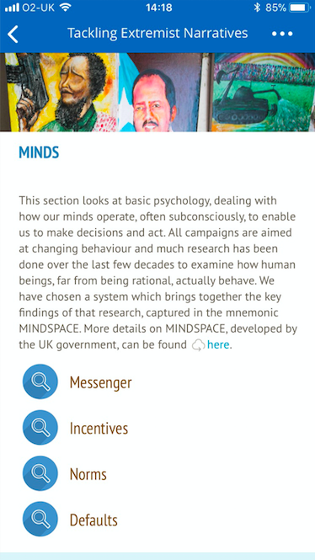
Tackling Extremist Narratives
Employing behavioral change techniques

Slide 21
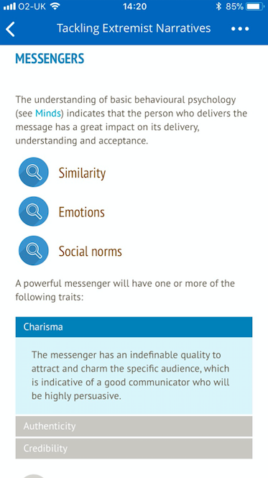
Tackling Extremist Narratives
Looking at the power of Messengers

Slide 22
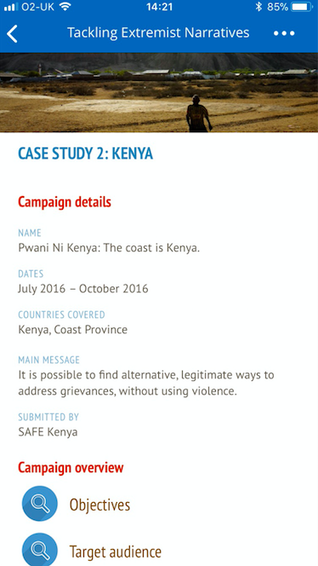
Tackling Extremist Narratives
Practical Case Studies

Slide 23
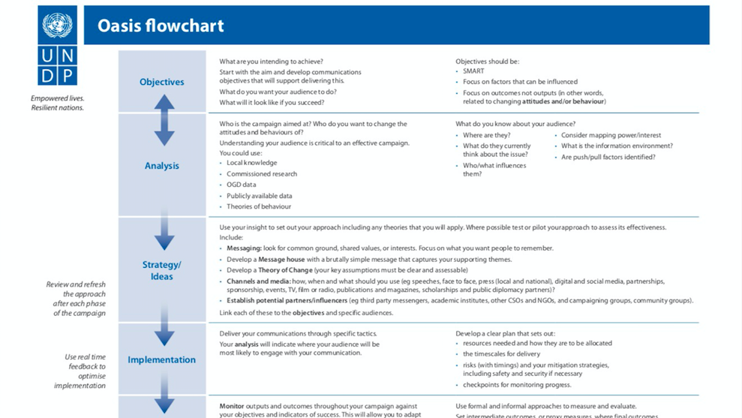
Tackling Extremist Narratives
Downloadable Tools – OASIS Flowchart

Slide 24
CONCLUSION
Narratives can be born via a huge variety of channels, technology is only a factor as narratives will develop anyway. But by understanding the extremist narratives deployed and promoting local holistic solutions through the prism of communication we can work towards the prevention of violent extremism.

